Slide 1

Phishing Website Detection using ML
Vishwa Shah
Urja Naik
Shilpi Soni

Slide 2
Introduction
Phishing websites disguise as trustworthy websites in order to gain the trust of their victims, and malicious parties use them to obtain sensitive information from their victims.
Attackers changes the subdomain and file path(If it contains in the URL) or making the typo mistake to look like the legitimate website. So to identify the phishing website mainly we need to breakdown the URL to look what each parts of the URL contains.
Notes:
Why it is important to detect phishing website
How to identify the phishing website using URL.
Subdivision of the URL

Slide 3
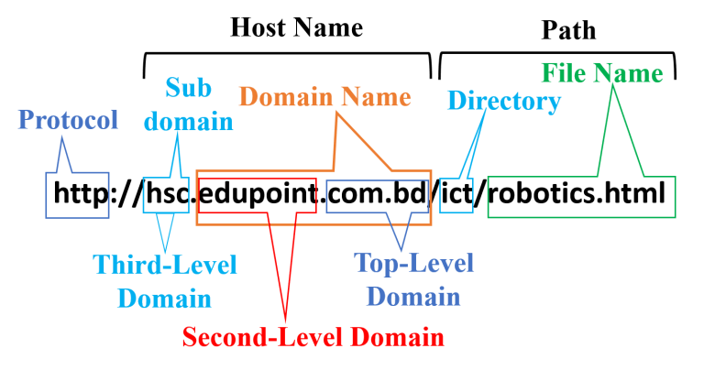

Slide 4
Data
We took the dataset from mendeley data named “Phishing website Dataset”.
There are total 111 features from which 4 features namely domain_in_ip, server_client_domain, email_in_url , domain_spf are categorical and rest is numerical
Notes:
Source of the Data
NUmber of features (NUmeric and categorical)
Distribute the features in to the categories

Slide 5
Criteria | Features
URL based features | Qty_dot_url,qty_hyphen_url,qty_underline_url, qty_slash_url, qty_questionmark_url,qty_equal_url,qty_at_url, length_url
Domain based features | qty_dot_domain, qty_hyphen_domain, qty_underline_domain, qty_slash_domain, qty_questionmark_domain, qty_equal_domain, qty_at_domain, qty_and_domain,

Slide 6
Criteria | Features
Directory related features | qty_dot_directory, qty_hyphen_directory, qty_underline_directory, qty_slash_directory, qty_questionmark_directory,
File related features | qty_dot_file, qty_hyphen_file, qty_underline_file, qty_slash_file, qty_questionmark_file, qty_equal_file, qty_at_file
URL Param related features | qty_dot_params, qty_hyphen_params, qty_underline_params, qty_slash_params, qty_questionmark_params, qty_equal_params
Other parameters related to external services | email_in_url, time_response, domain_spf asn_ip, time_domain_activation, time_domain_expiration

Slide 7
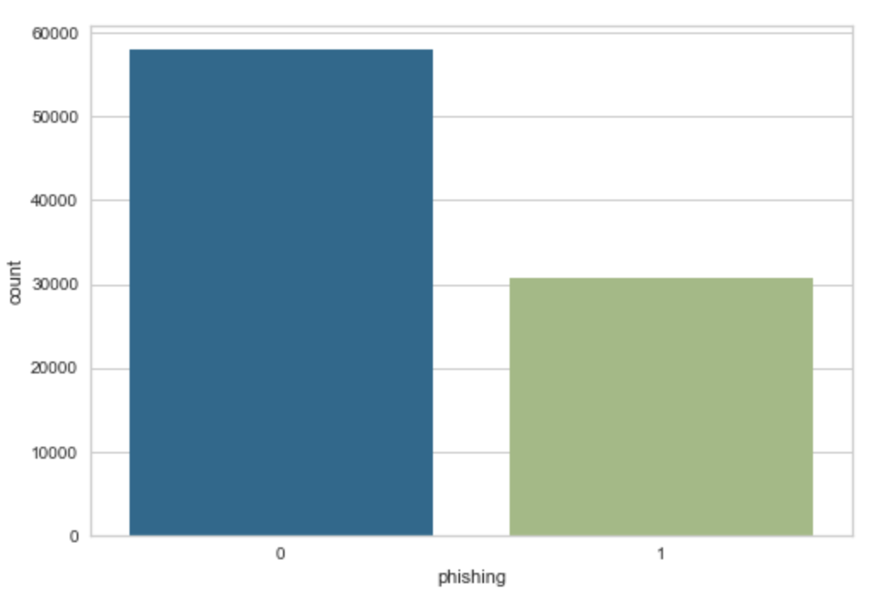
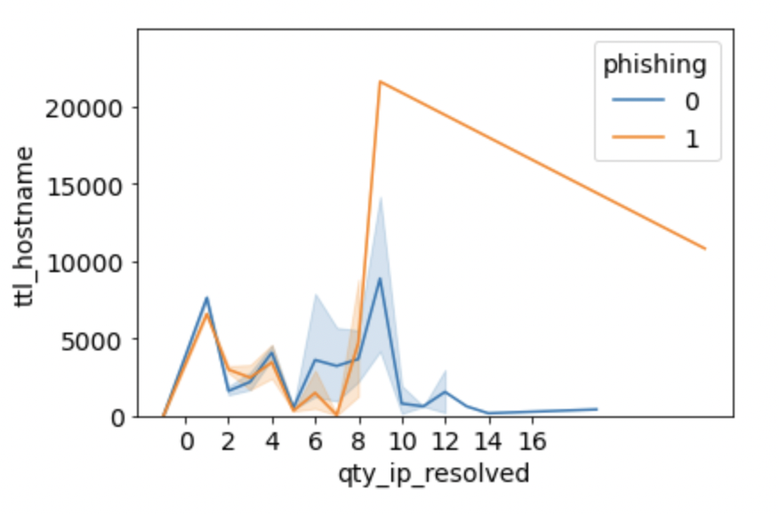
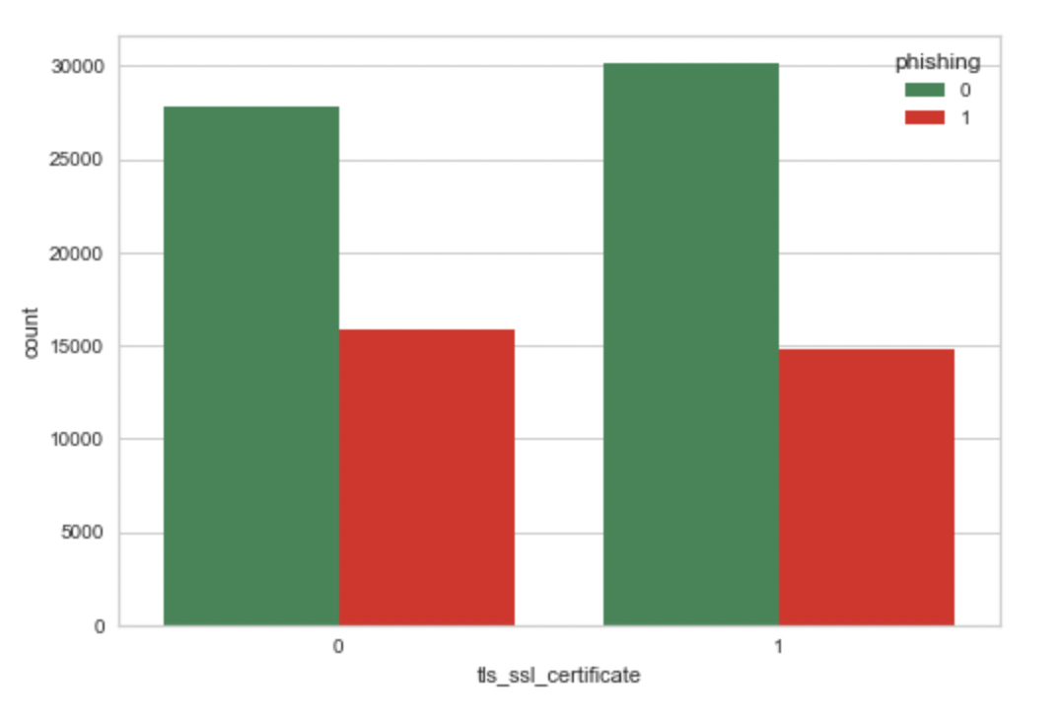
Data Visualization
Distribution of the dataset being phishing or not
Relation between Time to live of the packet and number of IP resolved with respect to target variable.
How having the SSL certificate affects to be the website phishing or not.

Slide 8
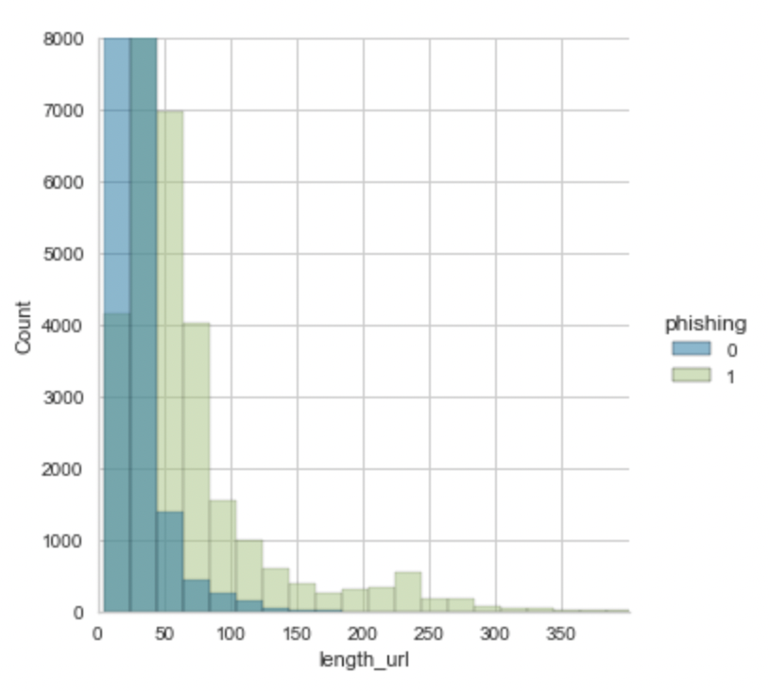
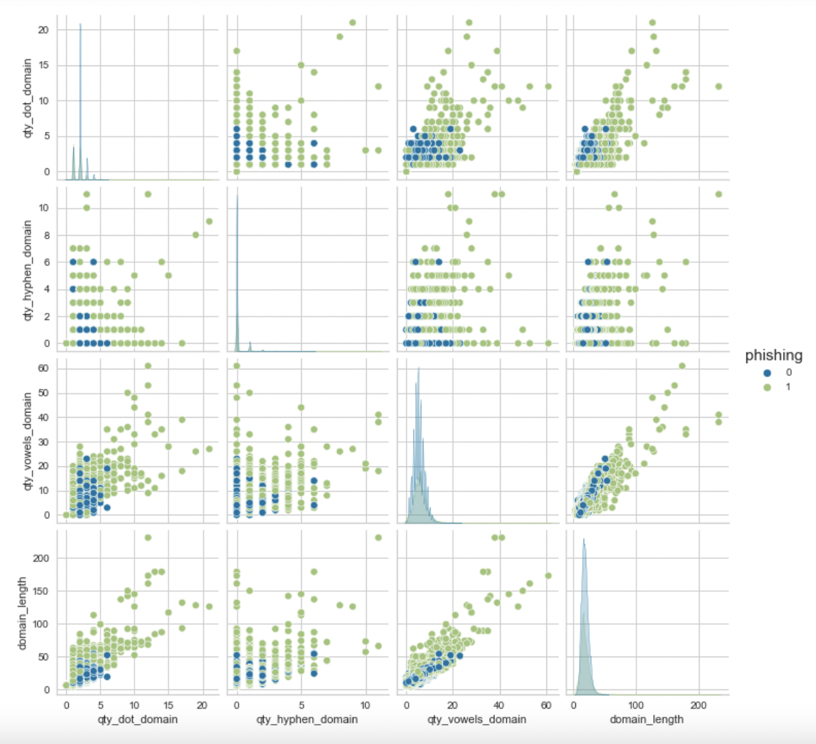
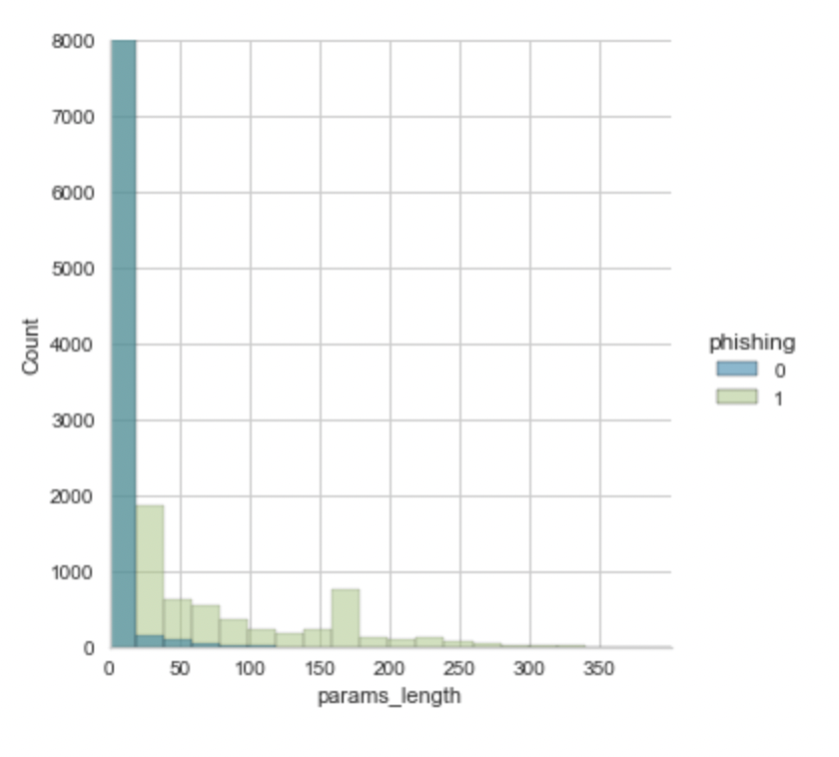
Data Visualization
Mutual Relationship in domain related feature.
As the length of parameters are increased it is more likely to be the phishing URL

Slide 9
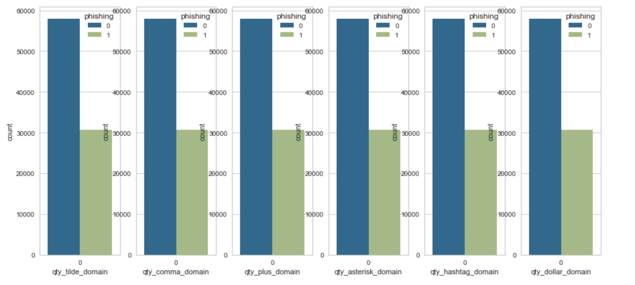
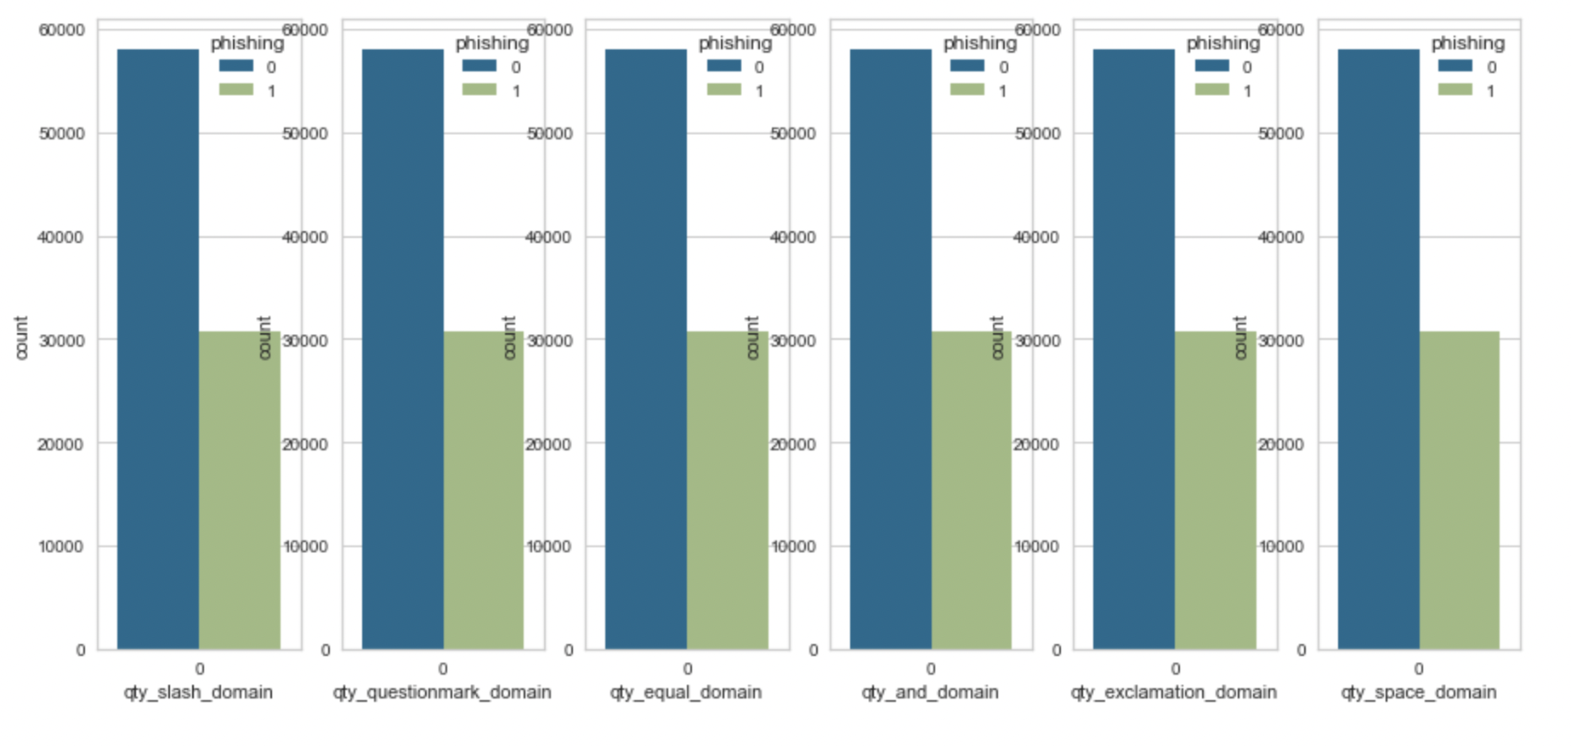
Data Visualization
Many Domain related columns having constant value

Slide 10
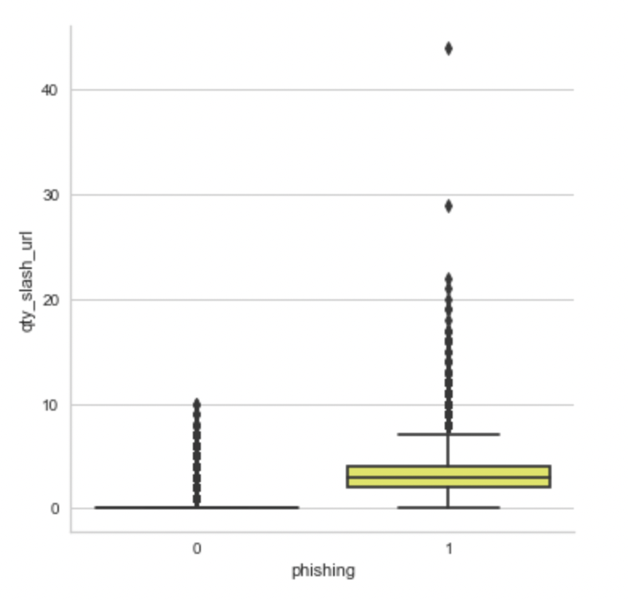
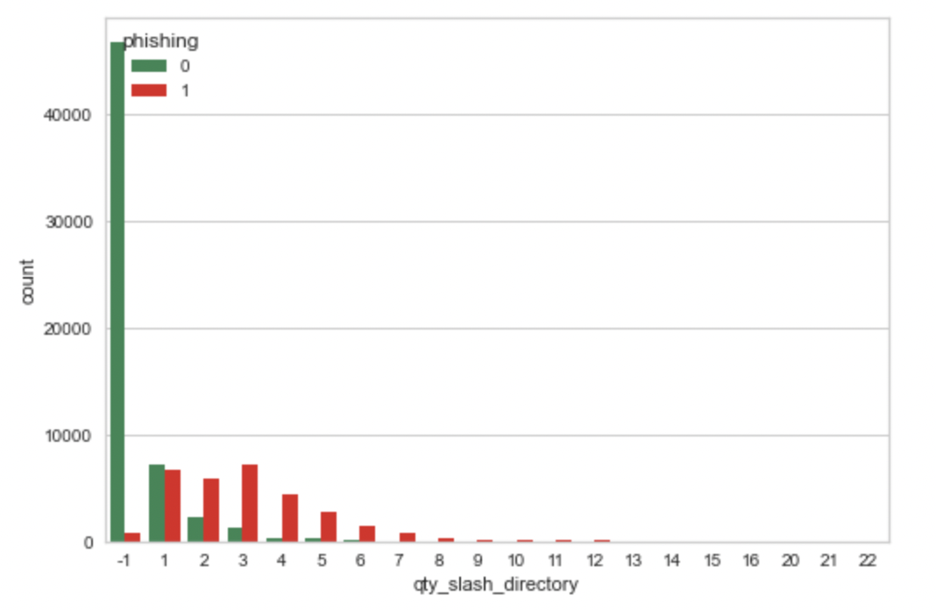
Data Visualization
Having higher number of the slash in the URL, increase the probability of being the website phishing

Slide 11
Data Cleaning
Remove the columns having the constant value
Remove the column having the noise greater than 60%
Handle the data having the noise lesser than 60%
Replace the value with the mean/mode
Replace the value with median/mode
Notes:
Duplicate values
Missing values or inappropriate values

Slide 12
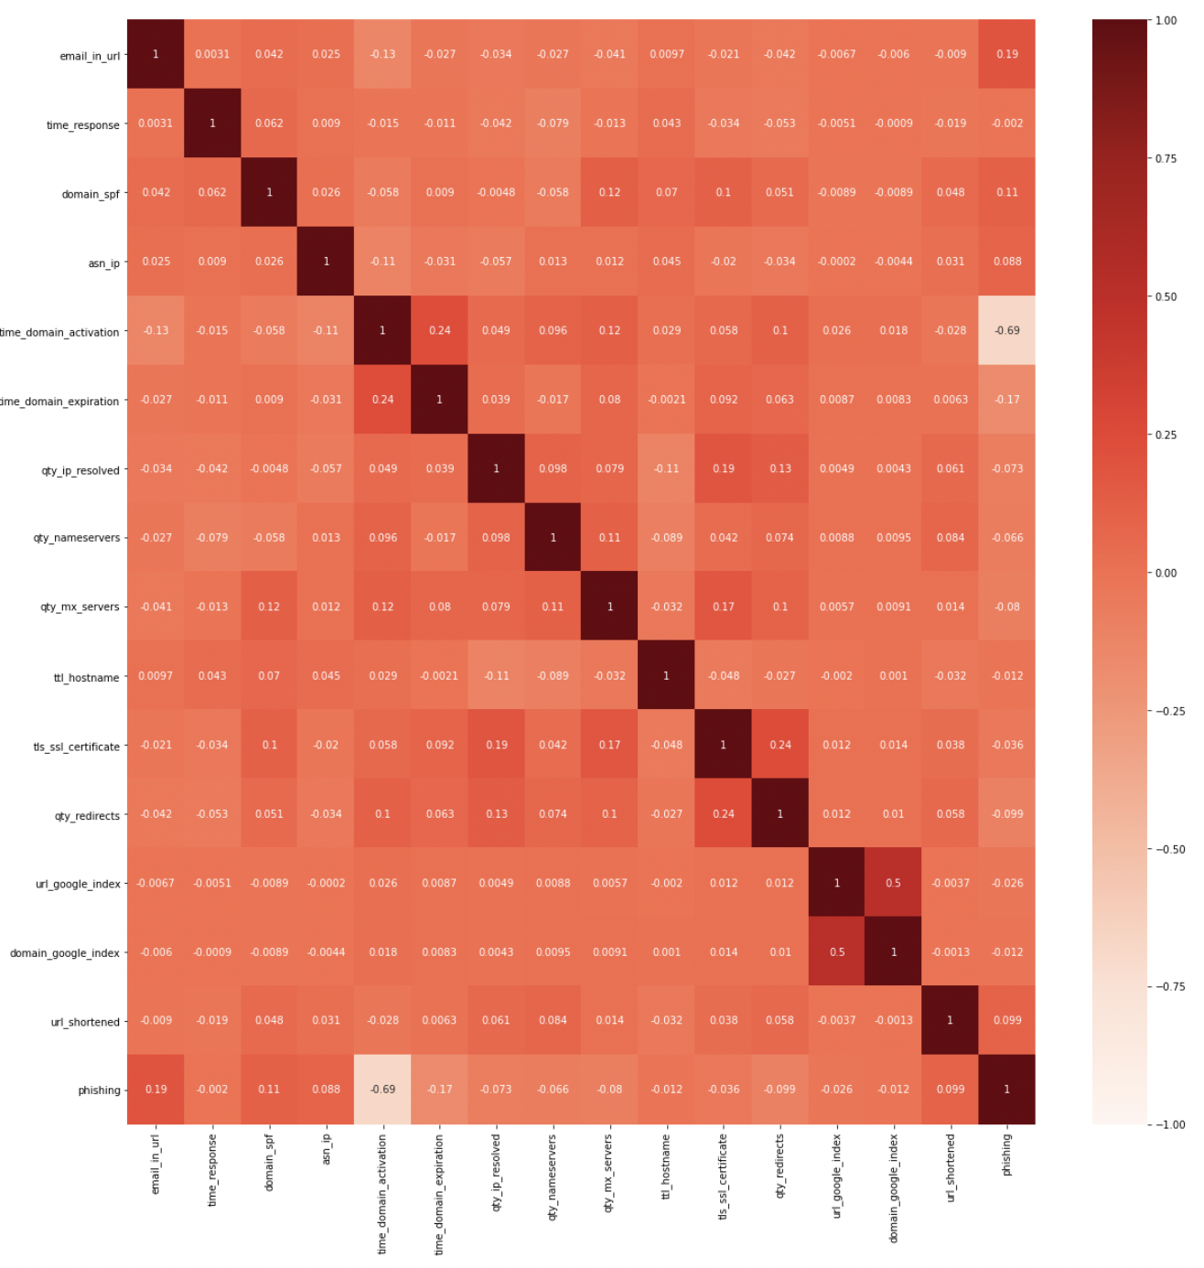
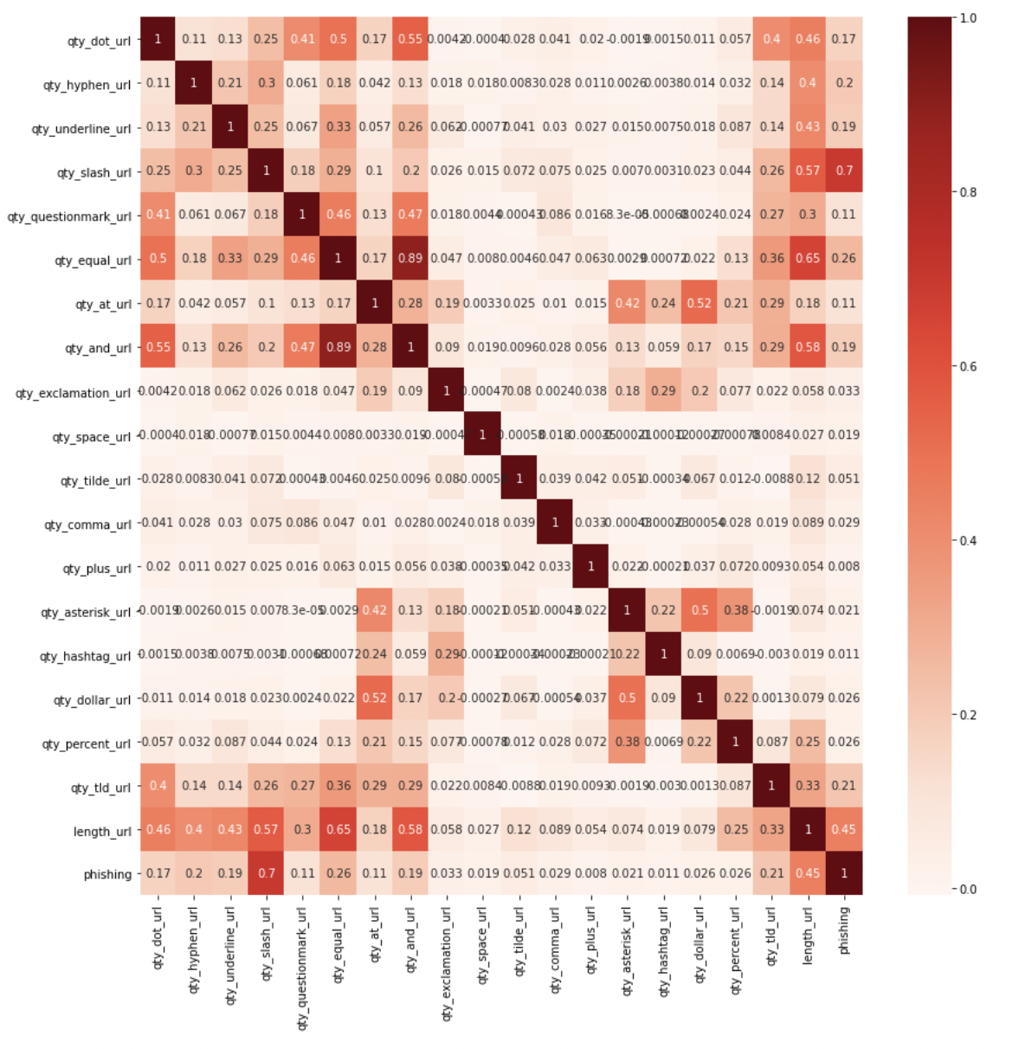
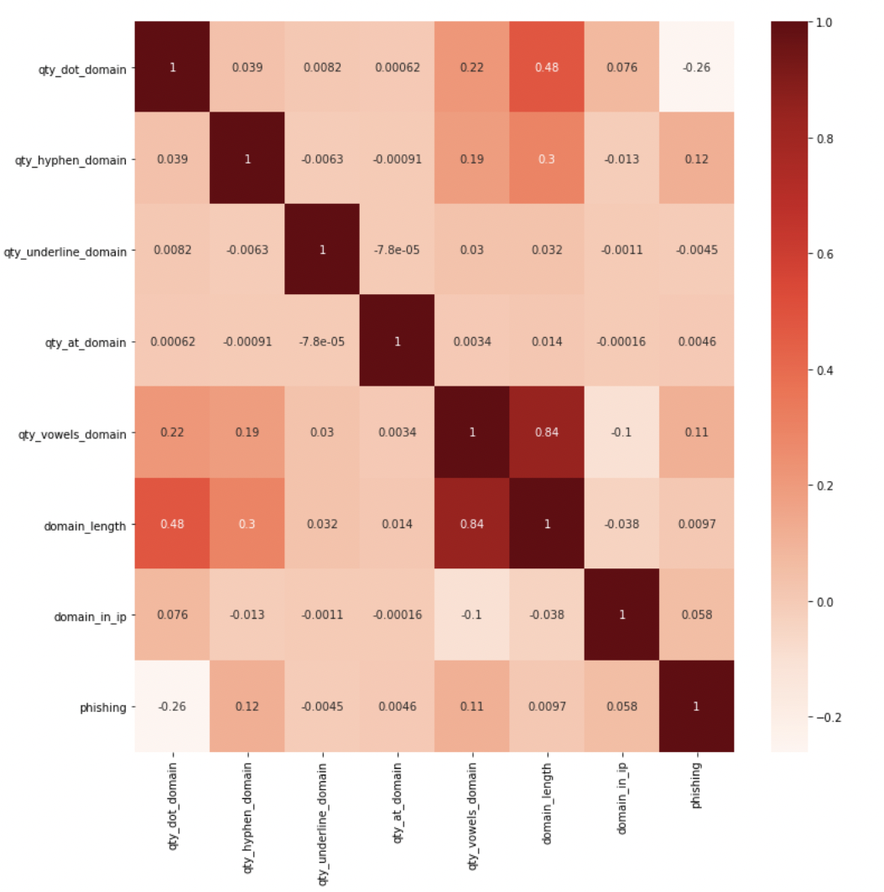
Feature Selection
Find the mutual correlation between the features resides in same category using correlation heatmap
Notes:
Using corelation heatmap
Using mutual information
PCA

Slide 13
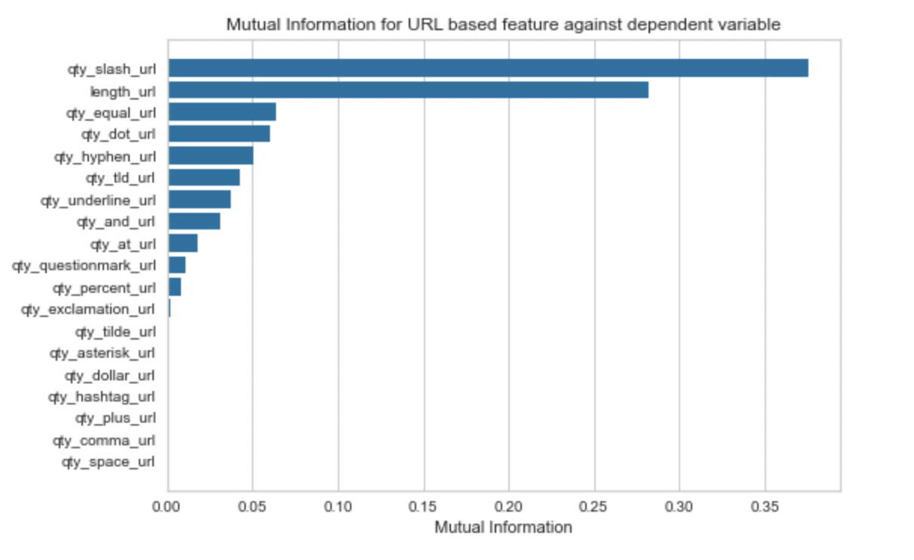
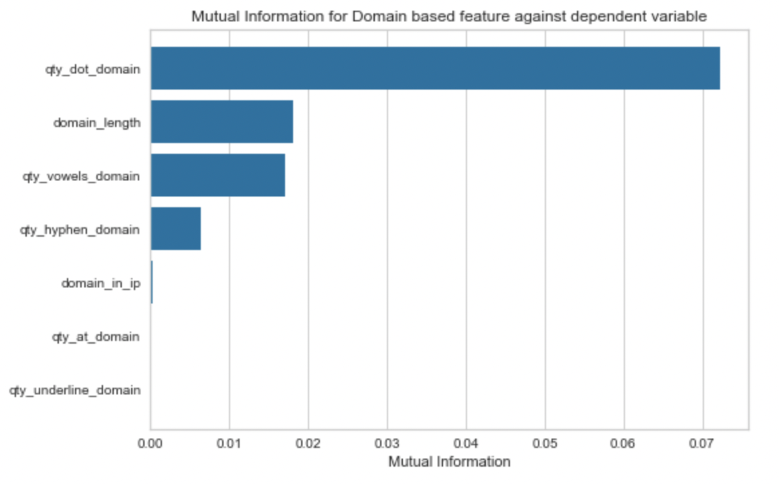
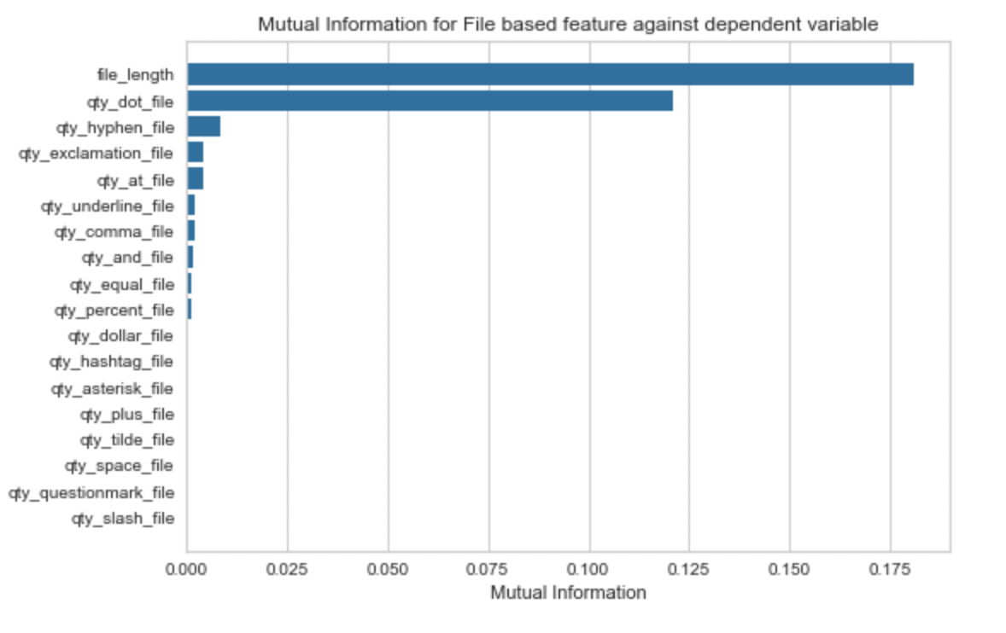
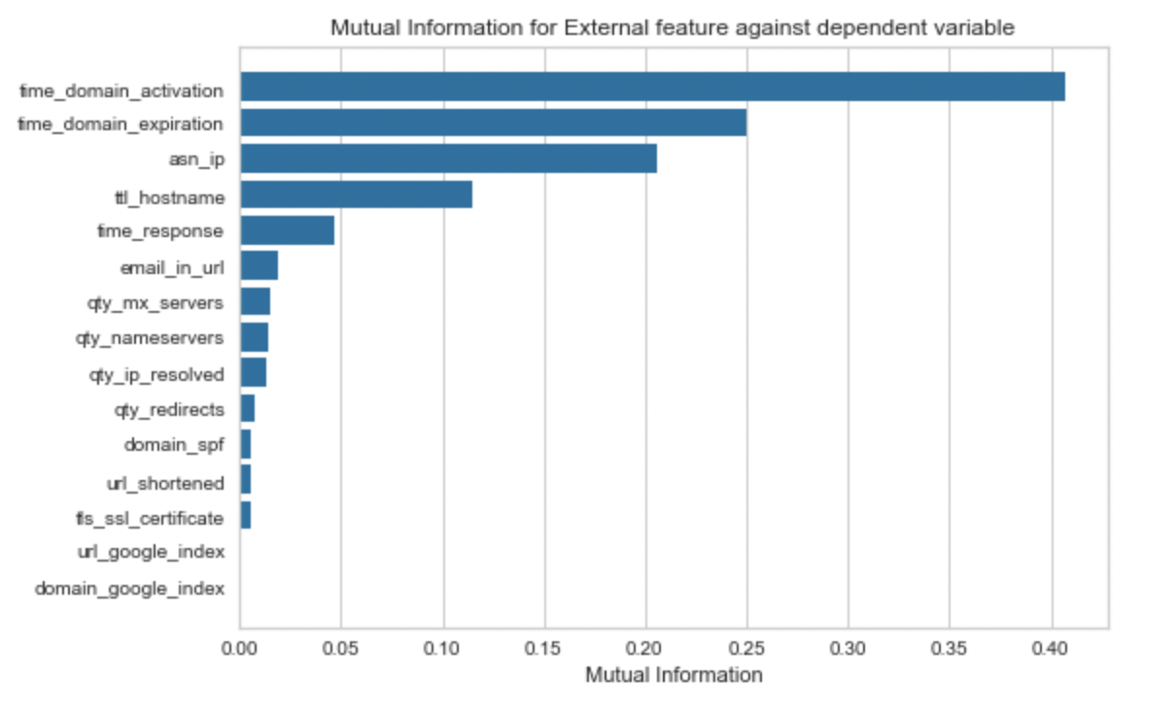
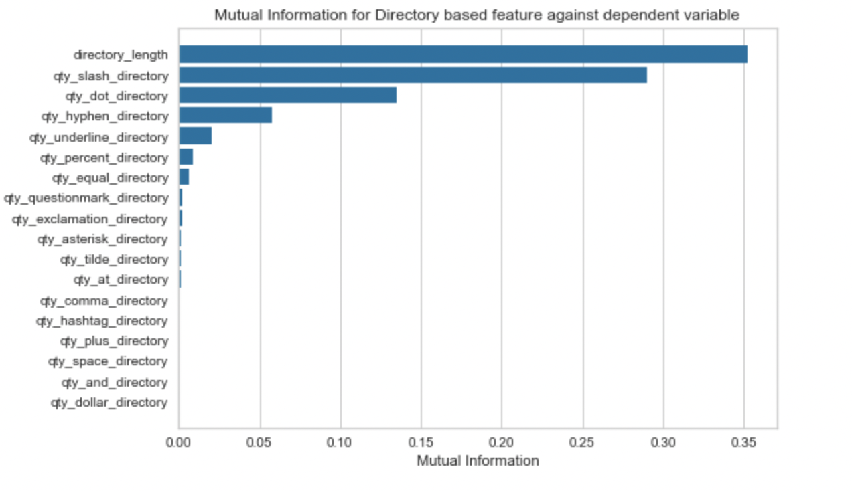
Feature Selection
Find the mutual information for the features resides in same category

Slide 14
Models And Evaluation
Model | Best Hyperparameter | Accuracy | Precision | Recall | Time taken for algorithm convergence
Logistic Regression | 'C': 0.1, 'penalty': 'l2', 'solver': 'liblinear' | 93% | 95% | 95% | 47 s
Naive Bayes Classifier | 'var_smoothing': 0.053 | 87% | 86% | 97% | 36 s
K nearest Neighbors | 'metric': 'manhattan', 'n_neighbors': 3, 'weights': 'distance' | 97.85% | 98% | 98% | 45 min
Random Forest | 'max_features': 'log2', 'n_estimators': 1000 | 98.5% | 99% | 99% | 30 min

Slide 15
Models And Evaluation
Model | Best Hyperparameter | Accuracy | Precision | Recall | Time taken for algorithm convergence
Support Vector Machine | 'C': 50, 'gamma': 'scale', 'kernel': 'rbf' | 97.4% | 98% | 98% | 1 hr 15 min
Stacking | Use Best Hyperparameter for the LR, SVM,Random Forest , KNN, NB | 98.4% | 99% | 99% | 400 s
XGBoost | 'learning_rate': 1, 'max_depth': 5, 'max_features': 2, 'n_estimators': 150 | 98.5% | 99% | 99% | 48 s

Slide 16
Thank You.

